Slide 1


Programming Assignment 2

Slide 2
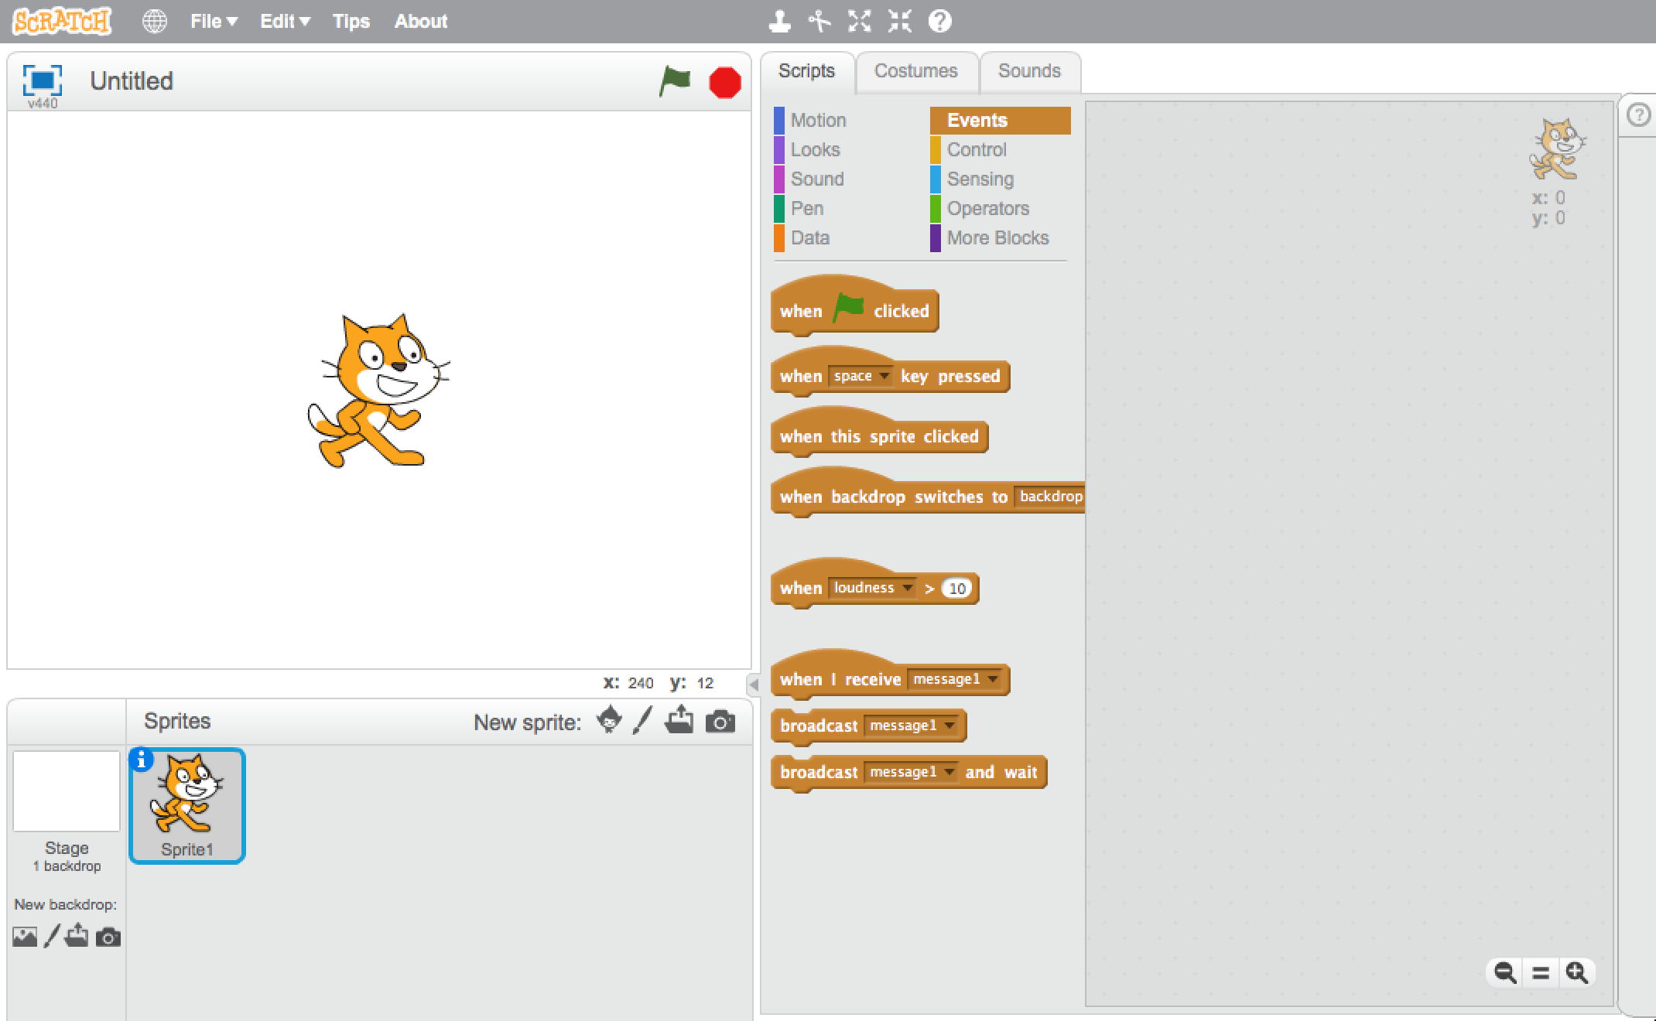
Assignment 2
Let’s make the sprite follow your hand.
Start by opening the project file: assignment2.sb2
You can do this by clicking the following in the menu on the top of the window:
File -> Open
Then select the file: assignment2.sb2

Slide 3
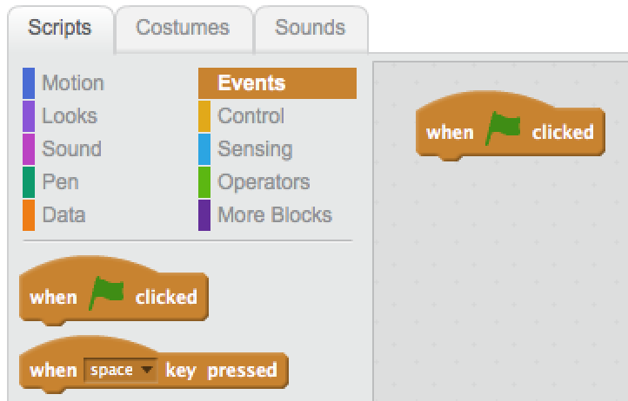
Assignment 2
Select ‘Events’ below the Scripts tab.
Now drag ‘when (flag) clicked’ to the programming area, which is on the right side of the window.

Slide 4
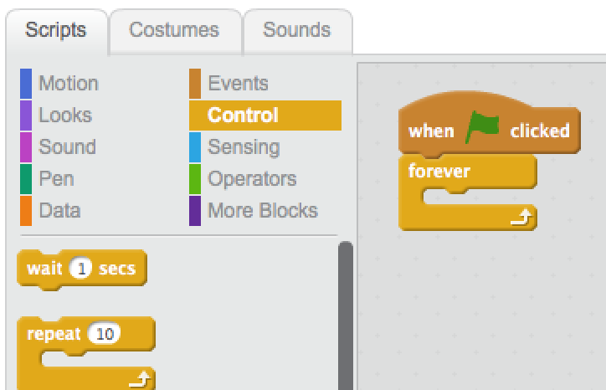
Assignment 2
Select ‘Control’ below the Scripts tab.
Now drag the building block ‘forever’ to the programming field, directly below the previously inserted ‘when (flag) clicked’ building block.

Slide 5
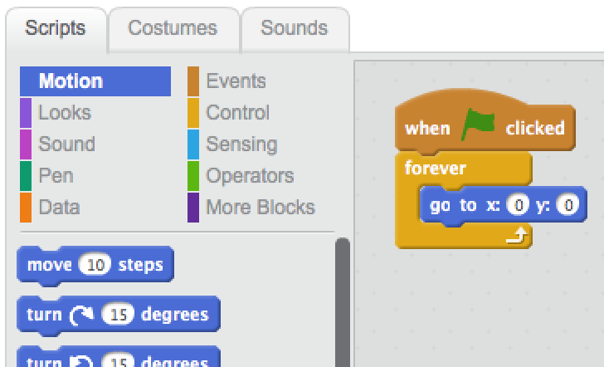
Assignment 2
Select ‘Motion’ below the Scripts tab.
Now drag the building block ‘go to x: 0 y: 0’ to the programming field, inside the ‘forever’ building block.

Slide 6
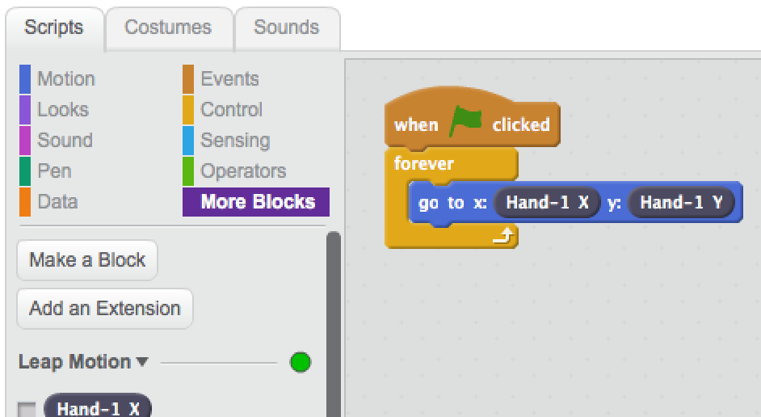
Assignment 2
Select ‘More Blocks’ below the Scripts tab.
Now drag building block ‘Hand-1 X’ to the programming field and place it right after the x inside the ‘go to x: 0 y: 0’ building block, replacing the first 0.
You can now repeat the previous step with ‘Hand-1 Y’.

Slide 7
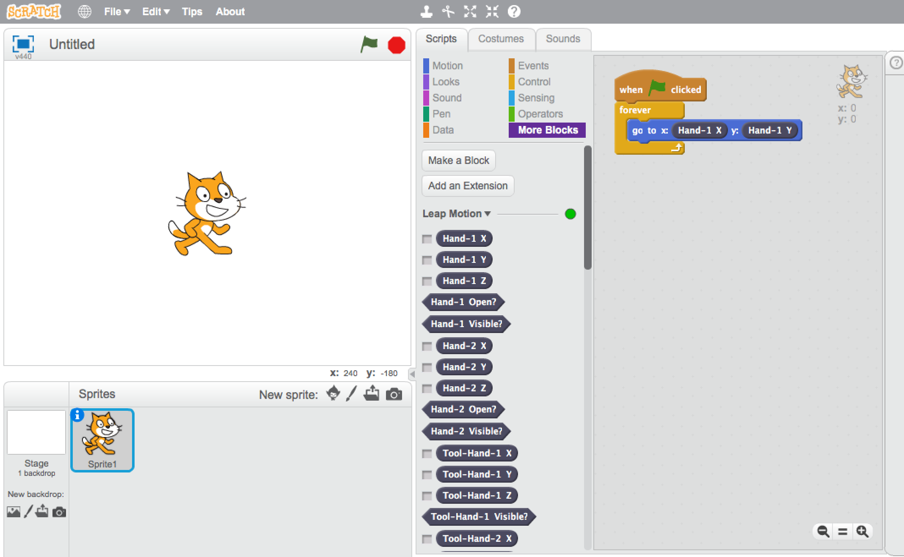
Assignment 2
Now click the green flag above your sprite and see what happens when you move your hand above the Leap Motion!

Slide 8
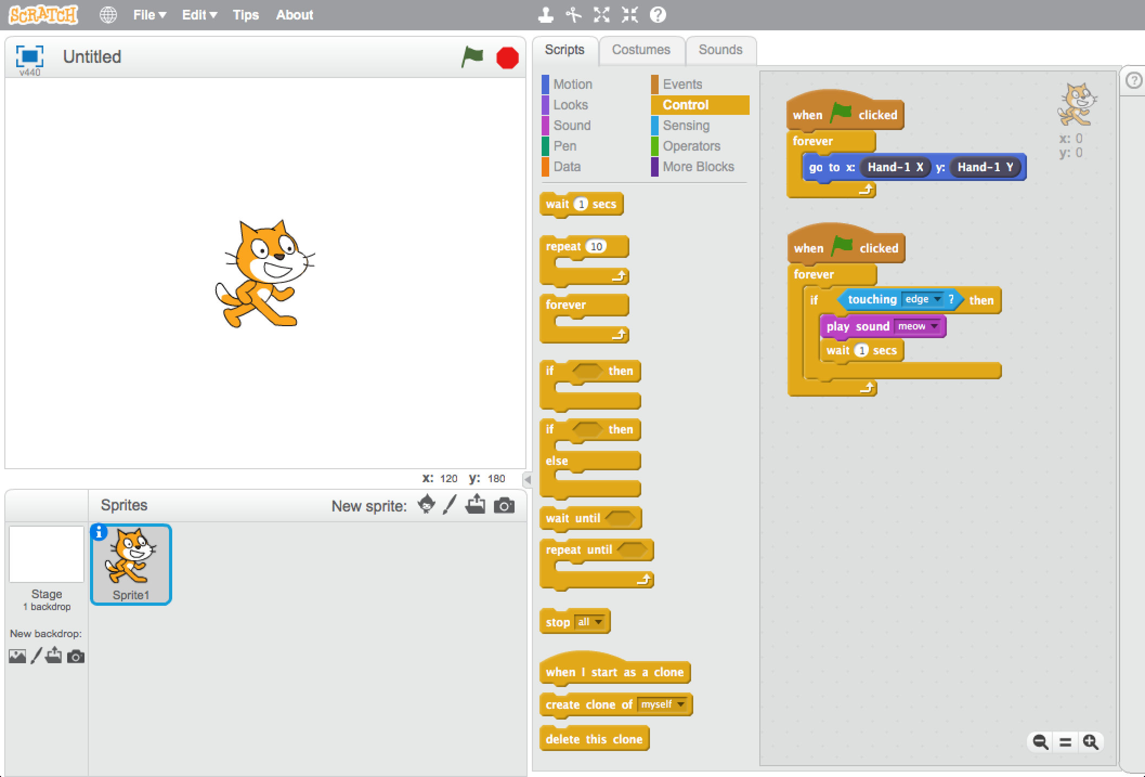
Assignment 2
Now it’s your job to program the sprite to make a sound when it touches the edge of the screen
The next page shows the answer, but please try it yourself first. This way you will learn much more!

Slide 9
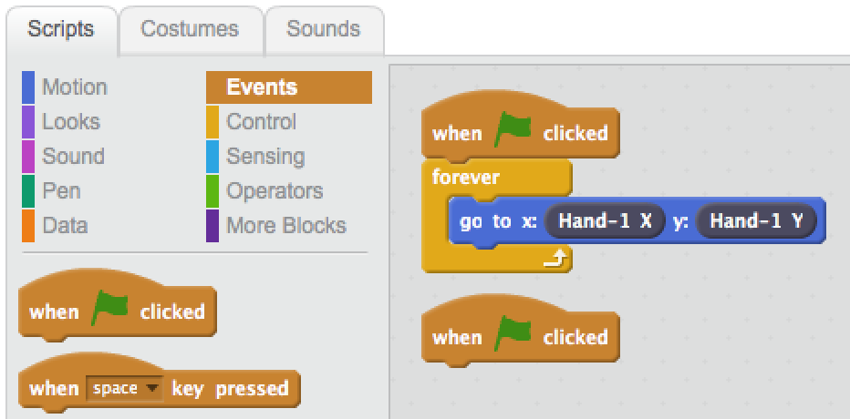
Assignment 2
Select ‘Events’ below the Scripts tab again.
Now drag another ‘when (flag) clicked’ to the programming area.

Slide 10
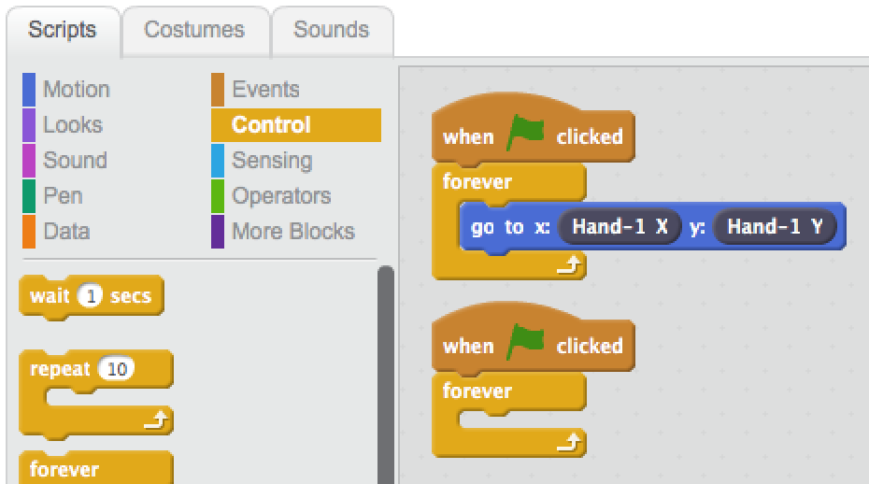
Assignment 2
Select ‘Control’ below the Scripts tab.
Now drag the building block ‘forever’ to the programming field, directly below the previously inserted ‘‘when (flag) clicked’ building block.

Slide 11
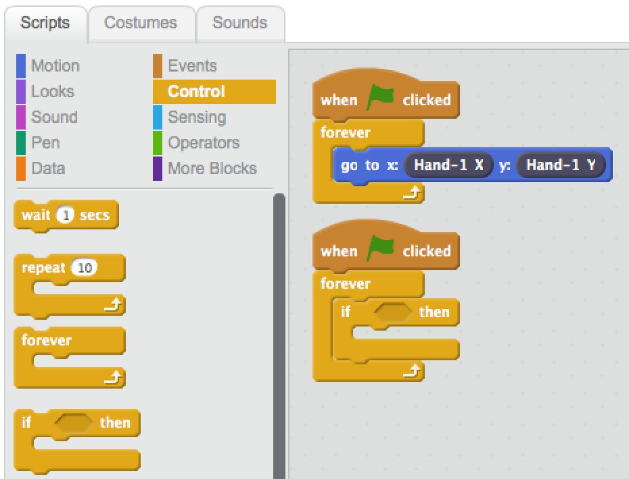
Assignment 2
Now drag the building block ‘if <> then’ to the programming field, inside the last inserted ‘forever’ building block.

Slide 12
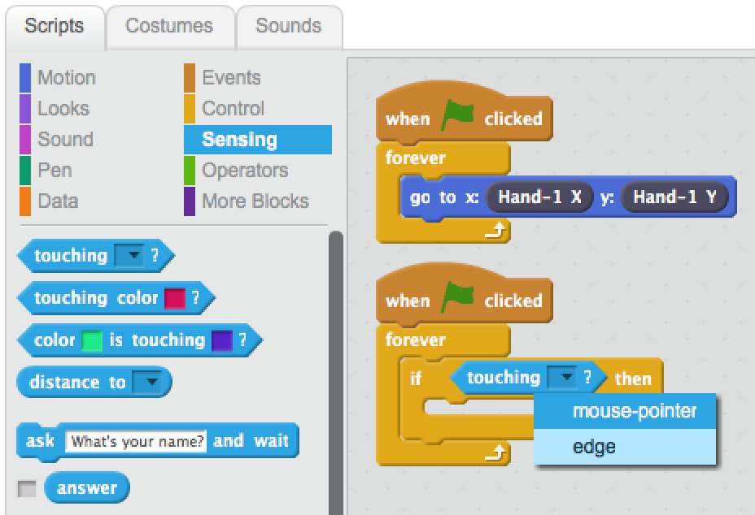
Assignment 2
Select ‘Sensing’ below the Scripts tab.
Drag the building block ‘touching [] ?’ to the programming field, on the <> of the ‘if <> then’ building block.
Now select ‘edge’ from the dropdown in the previously inserted ‘touching [] ?.

Slide 13
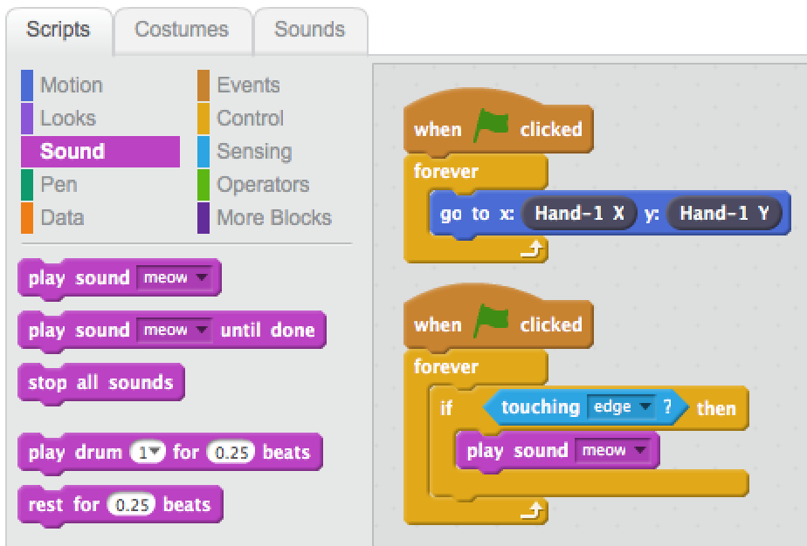
Assignment 2
Select ‘Sound’ below the Scripts tab.
Now drag the building block ‘play sound [meow]’ to the programming field, inside the ‘if <> then’ building block.

Slide 14
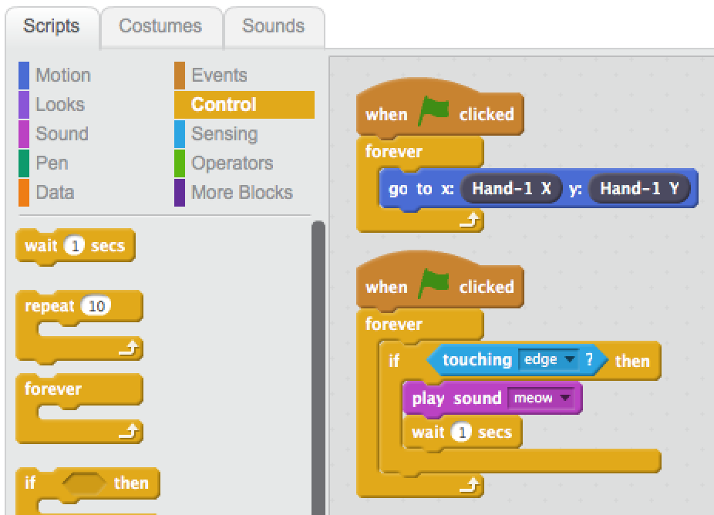
Assignment 2
Select ‘Control’ below the Scripts tab.
Now drag the building block ‘wait 1 secs’ to the programming field, directly below the ‘play sound [meow]’ building block.

Slide 15
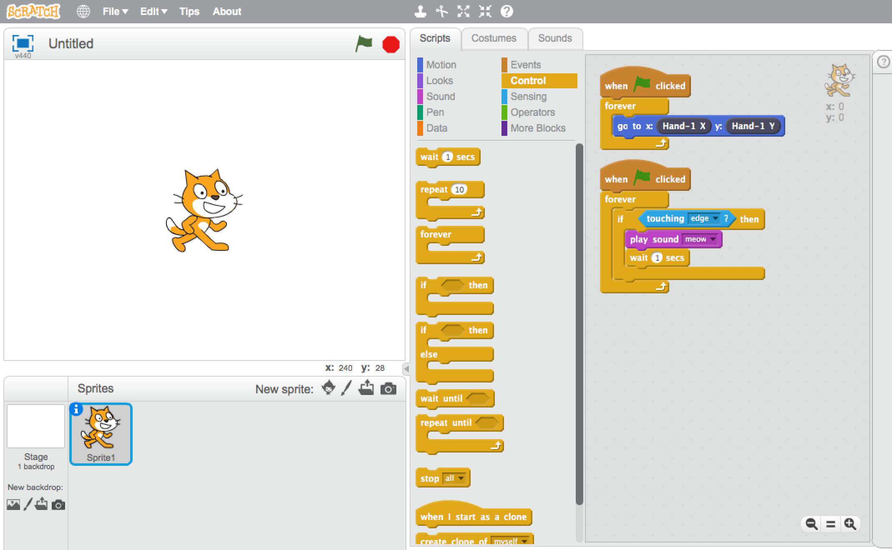
Assignment 2
If you click the green flag above your sprite, you will see that the sprite will follow your hand. And when the sprite touches the edge, you will hear a meow sound.

